Slide 1
Contest programming refresher
[5/31/2021]

Slide 2
Table of Contents
Binary search
Prefix sum array
Ad-hoc problem

Slide 3
Problems
If you are already familiar with binary search/prefix sum arrays, you can try these problems (register for an account to submit if you don’t have one):
https://cses.fi/problemset/task/1094 (easy)
https://codeforces.com/contest/1526/problem/C2 (harder)
https://codeforces.com/contest/1348/problem/D (harder)

Slide 4
Hackerrank
If you are still new to coding, you can try some beginner challenges:
https://www.hackerrank.com/domains/python?filters%5Bdifficulty%5D%5B%5D=easy (Python)
You can Google how to set up Python, or use an online workspace like CSAcademy IDE.

Slide 5
Higher-lower game
Consider the following:
I’ve picked a random number between 1 and 100, and you can repeatedly guess the number. Upon guessing, I’ll tell you if my number is higher or lower. How would you play this game to get the number in as few guesses as possible?
Questions:
What number would you initially guess?
Immediately after you guess the first number, what number would you guess next if i said my number was higher?

Slide 6
Question
Consider the following:
Given a sorted array*, find the largest element smaller than K.
A = [1, 2, 2, 3, 3, 4, 5, 6, 7]
Example: If K = 5, we want our program to output 4.
*array = ordered list of elements. You can access elements using 0-based indexes, for example in the above array A, A[0] = 1, A[1] = 2, A[2] = 2, A[3] = 3, and so on.

Slide 7
Naive solution (Brute force)
Loop through the elements, maintaining a variable ans(for answer). Update our variable if a[i] > ans and a[i] < K. At the end, return ans.
Time complexity: O(N)
Can we do better?

Slide 8
Binary Searching
The main idea of binary searching is that since the array is sorted, all elements to the left of an index are either smaller or equal to the element at the current index, and all the elements to the right are either greater or equal to the element at the current index.
More formally, arr[i-1] <= arr[i] <= arr[i+1] for all indices i in the array.
Binary searching only works on sorted arrays.

Slide 9
Binary Searching Implementation
We essentially create a subarray where the answer is, which is represented by two indices. One index is our left endpoint (L), and one index is our right endpoint (R). The subarray is then arr[L], arr[L+1], arr[L+2] … arr[R-1], arr[R].
We then check the middle element (arr[mid]) of this subarray.
We can test our middle element on our condition, and then we can either move to the right subarray (red) or the left subarray (blue) accordingly.
<= arr[mid] | arr[mid] | >= arr[mid]
L
Mid
R

Slide 10
Binary Searching Implementation (Cont.)
Given a sorted array of size N, find the largest element smaller than K.
In this question, we check whether the middle element ((L+R)/2) is < K.
If it is, then we move to the right side (red), as we want to maximize our answer.
If it is not, then we move to the left side (blue), as all elements to the right of mid will also be greater than or equal to K.
To move to blue subarray, we change R to Mid-1.
To move to red subarray, we change L to Mid+1
<= arr[mid] | arr[mid] | >= arr[mid]
L
Mid
R

Slide 11
Simulation:
For example, given N = 9, K = 5
Value | 1 | 2 | 2 | 3 | 3 | 4 | 5 | 6 | 7
Index | 1 | 2 | 3 | 4 | 5 | 6 | 7 | 8 | 9
LEFT
MID
RIGHT
Check: is arr[mid] < K?
3 < 5, therefore ans is updated to 3
Since condition is met, we move to the right subarray (L = Mid + 1).

Slide 12
Simulation:
N = 9, K = 5
Value | 1 | 2 | 2 | 3 | 3 | 4 | 5 | 6 | 7
Index | 1 | 2 | 3 | 4 | 5 | 6 | 7 | 8 | 9
LEFT
MID
RIGHT
Check: is arr[mid] < K?
5 = 5, therefore ans is not updated (ans = 3)
Since condition is not met, we move to the left subarray (R = Mid - 1).

Slide 13
Simulation:
N = 9, K = 5
Value | 1 | 2 | 2 | 3 | 3 | 4 | 5 | 6 | 7
Index | 1 | 2 | 3 | 4 | 5 | 6 | 7 | 8 | 9
LEFT
MID
Check: is arr[mid] < K?
4 < 5, therefore ans is updated to 4
Since the subarray is now of length 1, the binary search ends.
RIGHT

Slide 14
Binary Searching Notes
Time complexity: O(logN)
At the start, we initialize the left endpoint to the start of the array and the right endpoint to the end of the array.
We find the middle element through: Mid = (L + R) / 2
If mid is a float (L+R is not even), then we can just use integer division (round down) as the midpoint. This doesn’t affect the answer at all.

Slide 15
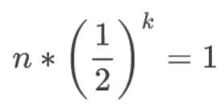
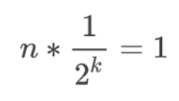
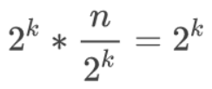


Binary Search Time Complexity
O (log n); running time grows in proportion to the logarithm of the input size
Everytime we do a check, our search range gets halved
Say we are binary searching through n elements

Slide 16
Binary Searching Code
Python
C++/Java
L = 1
R = N
ans = 0
while(L<=R): # while there are still subarrays
mid = (L+R)//2 # rounded down
if(arr[mid]<K):
ans = arr[mid]
L = mid + 1
else:
R = mid - 1
int L = 1, R = N, ans = 0;
while(L<=R) {
int mid = (L+R)/2;
if(arr[mid] < K) {
ans = arr[mid];
L = mid+1;
}
else {
R = mid-1;
}
}

Slide 17
Binary Search Final Notes
Although the time complexity of binary searching is O(logN), sorting an array takes O(N * logN) time.
For some problems, you can also binary search for the answer.
Easiest example of this would be finding the square root of a number without using any built-in functions

Slide 18
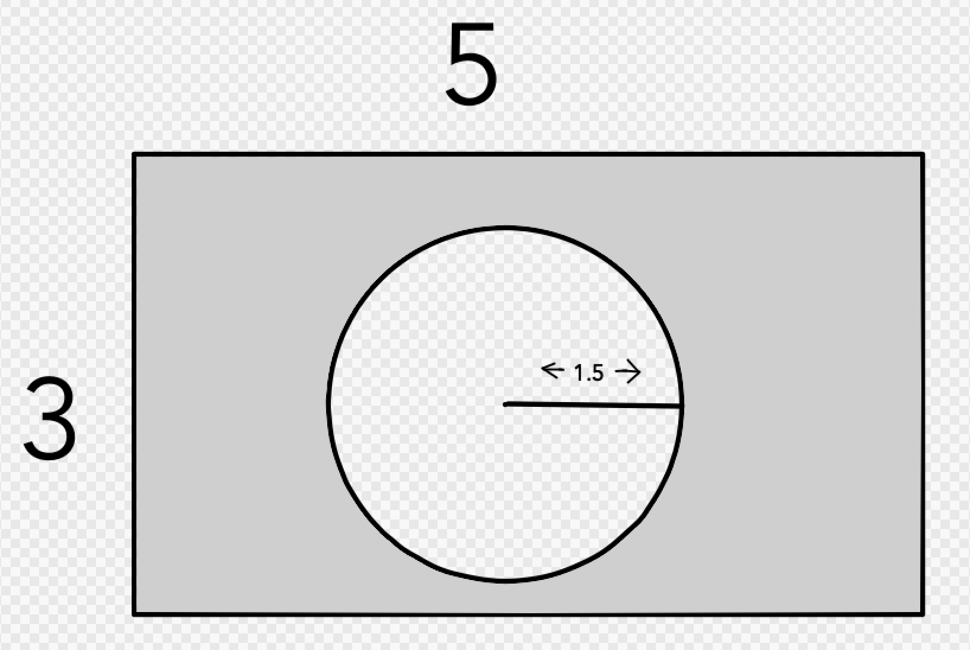
Consider: What is the area of the shaded region?

Slide 19
Introduction to Prefix Sum Arrays
Motivation: finding sum of any subrange of an array instantly
If you’re familiar with inclusion-exclusion from math contests, this is pretty much the same thing
Can also be extended to any reversible operation
Works on operations like addition, subtraction, multiplication, xor
Won’t work on GCD, bitwise and, etc
Can also be extended to multiple dimensions (e.g. 2D arrays)

Slide 20
Introduction to Prefix Sum Arrays Cont.
A prefix sum array is an array related to the original array in a way such that any index i in the prefix sum array stores the cumulative sum of all elements in the original array from 1 to i.
Assuming the i-th element of the prefix sum array is PSA[i],
Then PSA[i] is defined as orig[1] + orig[2] + orig[3] + … + orig[i]
Let us better understand this with a visualization.

Slide 21
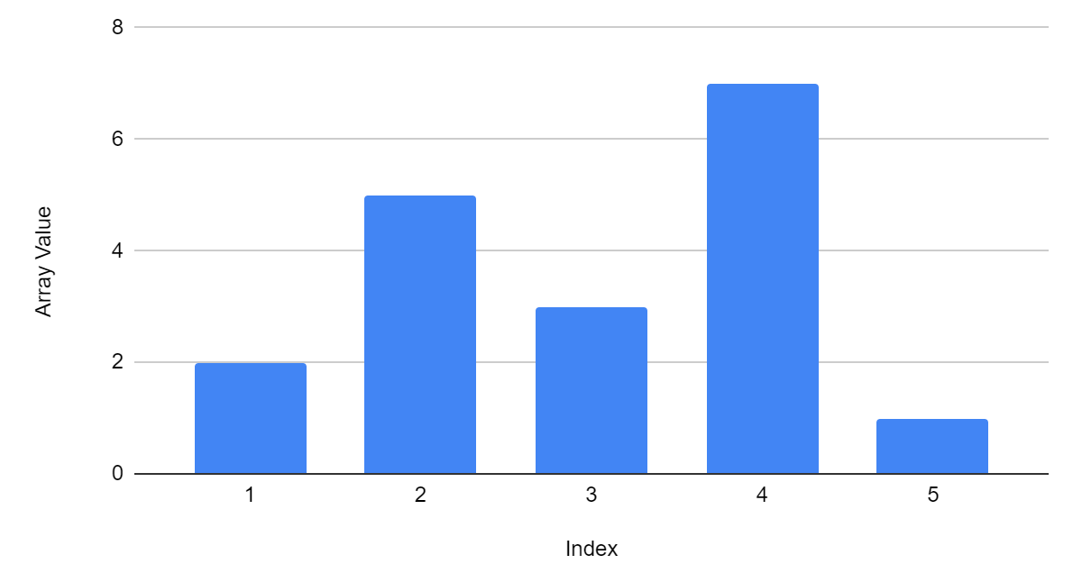
Visualization of PSA
Example Array:
Index | 1 | 2 | 3 | 4 | 5
Array | 2 | 5 | 3 | 7 | 1
Let us do a PSA on this original array.

Slide 22
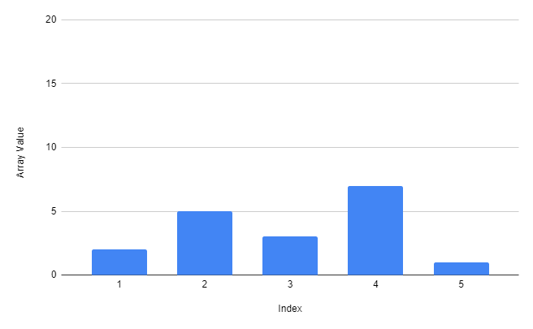
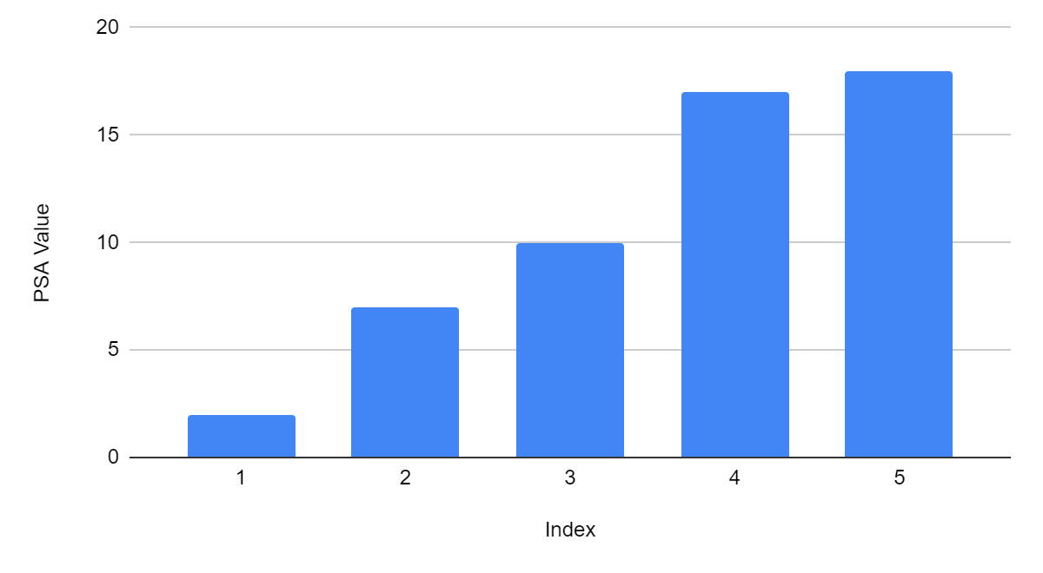
Visualization of PSA
Example Array:
Index | 1 | 2 | 3 | 4 | 5
Array | 2 | 5 | 3 | 7 | 1
PSA | 2 | 7 | 10 | 17 | 18

Slide 23
Applications of a Prefix Sum Array
After we construct a prefix sum array, we can find the sum of an interval [a, b] in constant or O(1) time.
If we query PSA[b] - PSA[a-1], we will find the sum of the interval [a, b] in the original array.
Why?
PSA[b] stores the sum of all elements from 1 to b (arr[1] + arr[2] + … + arr[b])
PSA[a-1] stores the sum of all elements from 1 - a-1 (arr[1] + arr[2] + … + arr[a-1])
If we subtract PSA[a-1] from PSA[b] then, we are getting the sum of all elements from a to b.
a
b
a
b
a-1

Slide 24
Building Prefix Sum Array
We can construct a PSA in O(n) time.
If we were to loop from 1 - i for every PSA[i], our building algorithm would take O(n^2), which is not an improvement in speed.
Instead, for every index, we can say that:
PSA[i] = PSA[i-1] + orig[i]
Since PSA[i-1] = orig[1] + orig[2] + … + orig[i-1]
Then PSA[i] = orig[1] + orig[2] + … + orig[i-1] + orig[i]
Also note that your original array and prefix sum array should be 1-indexed, meaning that the array starts at index 1. This is to avoid PSA[i-1] being a negative index.

Slide 25
Template PSA Code
PYTHON
CPP
#include <bits/stdc++.h>
using namespace std;
int orig[1000005], PSA[1000005], N, Q, a, b;
int main() {
cin >> N;
for(int i = 1; i <= N; i++) {
cin >> orig[i];
}
for(int i = 1; i <= N; i++) {
PSA[i] = PSA[i-1] + orig[i];
}
cin >> Q;
for(int i = 1; i <= Q; i++) {
cin >> a >> b;
a++; // add one since queries are 0-indexed
b++;
cout << PSA[b] - PSA[a-1] << "\n";
}
}
n=int(input())
orig=[0] # 1-indexed, add element at start of array
for i in range(n):
orig.append(int(input()))
PSA=[0]
for i in range(1, n+1):
PSA.append(PSA[i-1] + orig[i])
for i in range(int(input())): # loop through each query
a,b=map(int,input().split())
a+=1 # add one since queries are 0-indexed
b+=1 # but PSA should be 1 indexed
print(PSA[b]-PSA[a-1])

Slide 26
Template PSA problem
https://cses.fi/problemset/task/1646

Slide 27
Ad-hoc problem
https://cses.fi/problemset/task/1094/

Slide 28
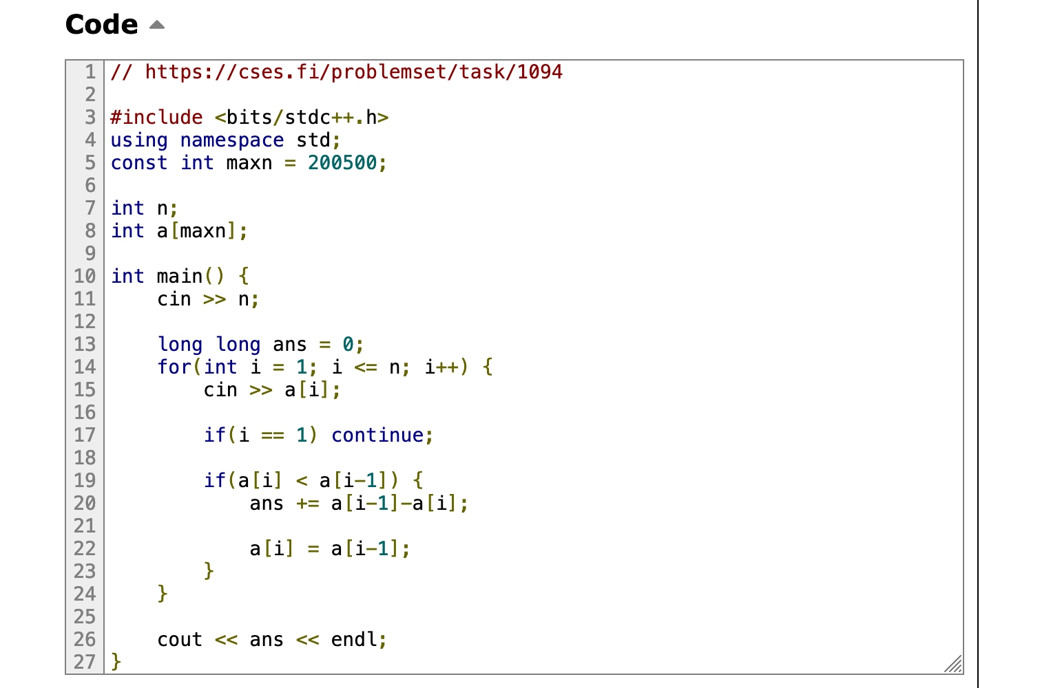
Solution
Notes:
Use long long to avoid overflow (won’t have this issue if you use Python)

Slide 29
Additional
https://usaco.guide/silver/prefix-sums?lang=cpp
https://usaco.guide/silver/binary-search?lang=cpp

